Slide 1



Collect Earth Online A New Design Concept
Billy Ashmall

Slide 2
Purpose
We would like the Collect Earth Online website to be:
Identifiable and well branded
User friendly
Users should know within seconds why they are there and what they are supposed to do next (Collaborate. Play. Map the world.)
Responsive to fit any device
This is very important especially in our Hub locations
Engaging to users
Users need to feel a sense of accomplishment
Users need to feel rewarded
Users need to feel excited about what they are doing
Intuitive to most people
Most of the actions we expect users to accomplish should be standard, and easy to understand
We should provide training videos for non-intuitive instances such as how to classify imagery, etc.
How do we accomplish this?

Slide 3
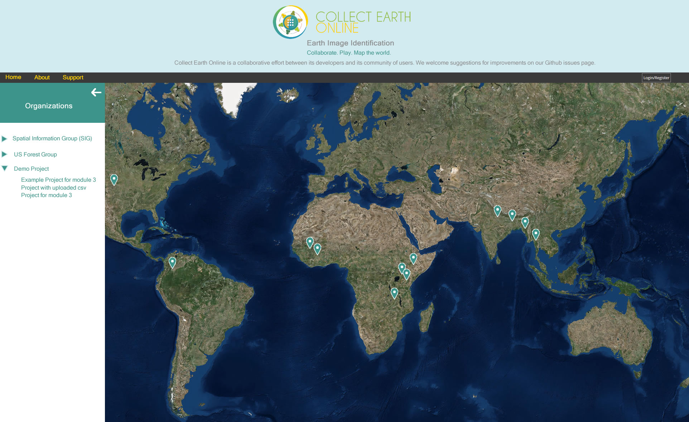
Proposed new look and feel for the home page
Initial call to action “Choose a project to get started”
Organizations are listed in the collapsible tree on the left.
Projects are listed when the Organization is expanded in the tree
All public projects are represented on the map with a marker.
Users can navigate the tree or the map to select projects.
When the user selects a project, they are navigated to that project’s dashboard

Slide 4
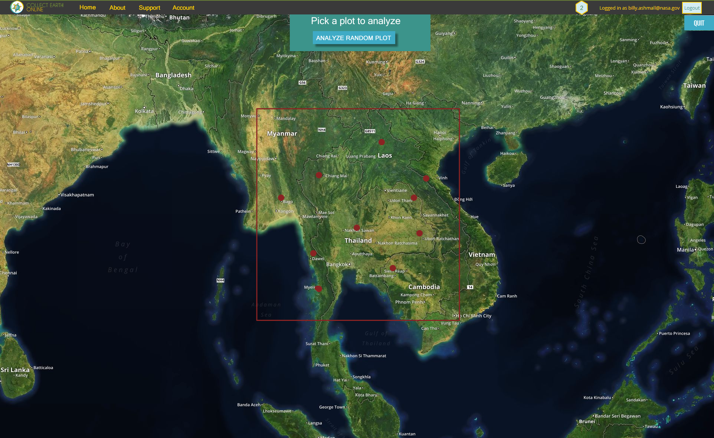
Project overview page (Dashboard)
User chose a project and is brought here.
They can see the project bounding box with all of the collection plots on the map.
The user may click a plot on the map to analyze or click the ANALYZE RANDOM PLOT button.
Of course the map is fully functional, zoom, pan, etc…
Quit takes them back to the Home page.
User can click on Account, the badge, or his name to access the account page.

Slide 5
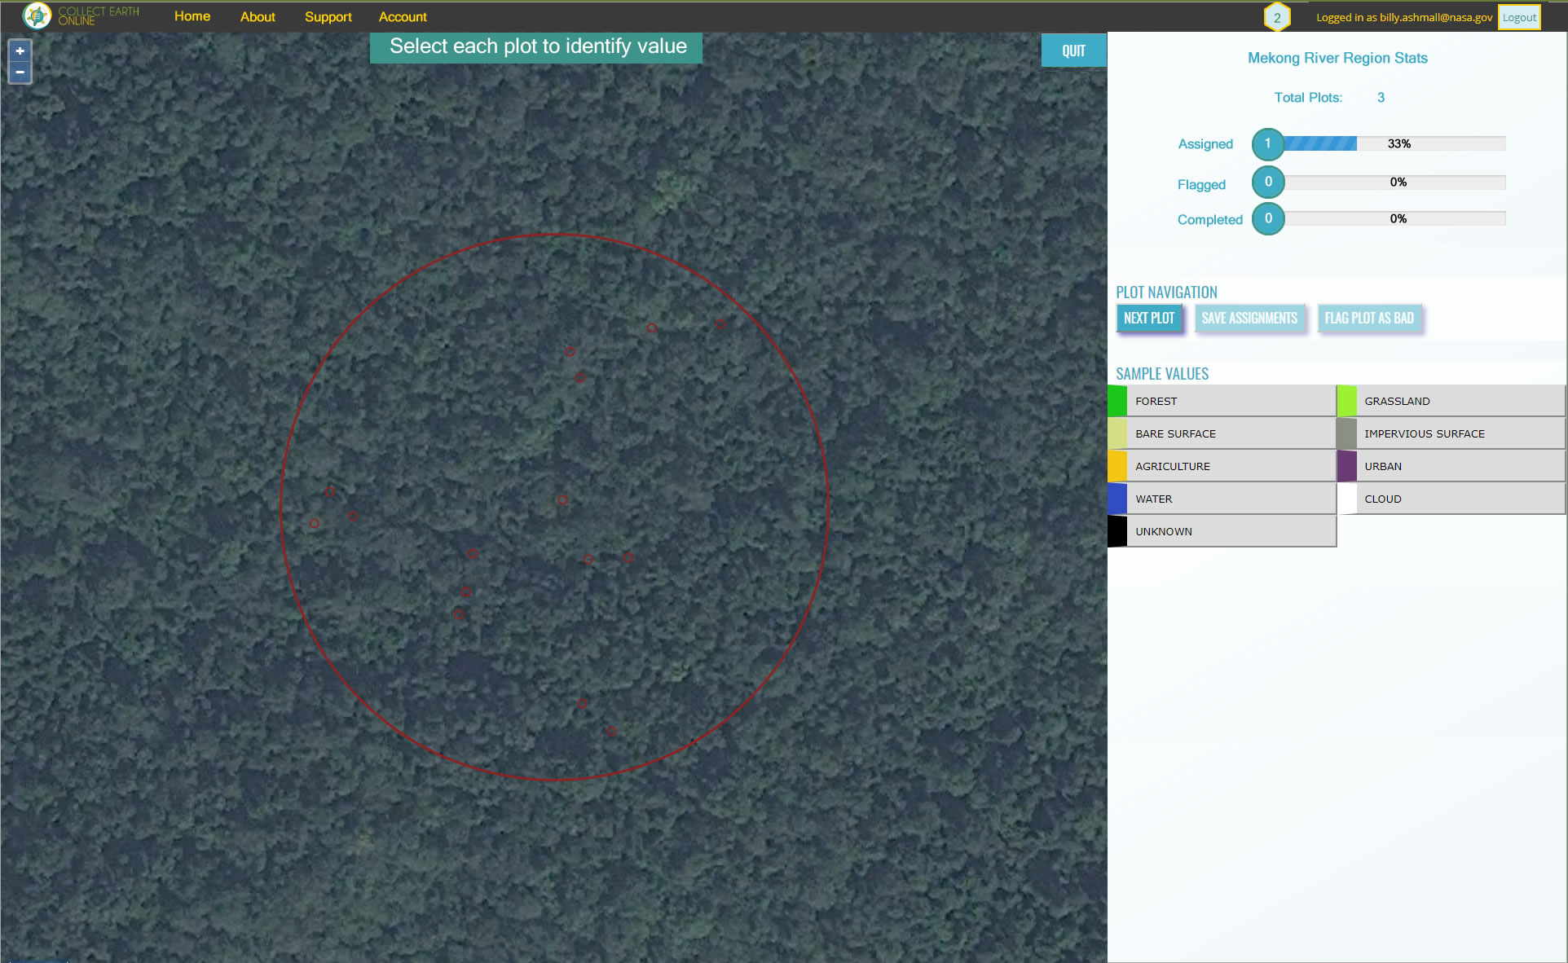
Plot Analysis
Call to action directs user to select each plot for identification
Project information is to the right in a visual format
Plot navigation is simple and self explanatory

Slide 6
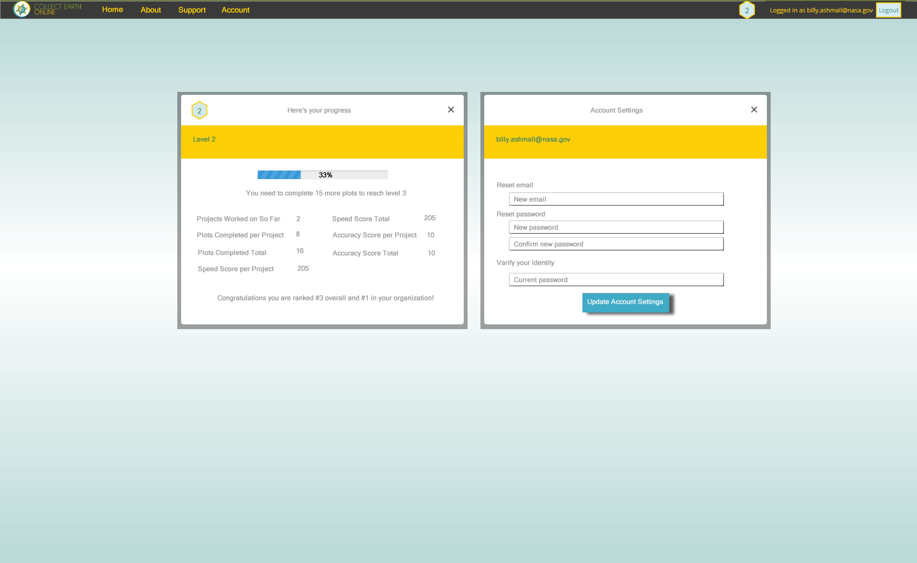
Account page
User can access stats such as:
Level
Level progress
Goal to next level
Exact stats on his projects and plots
User can also update the account here:
Change email
Reset password

Slide 7
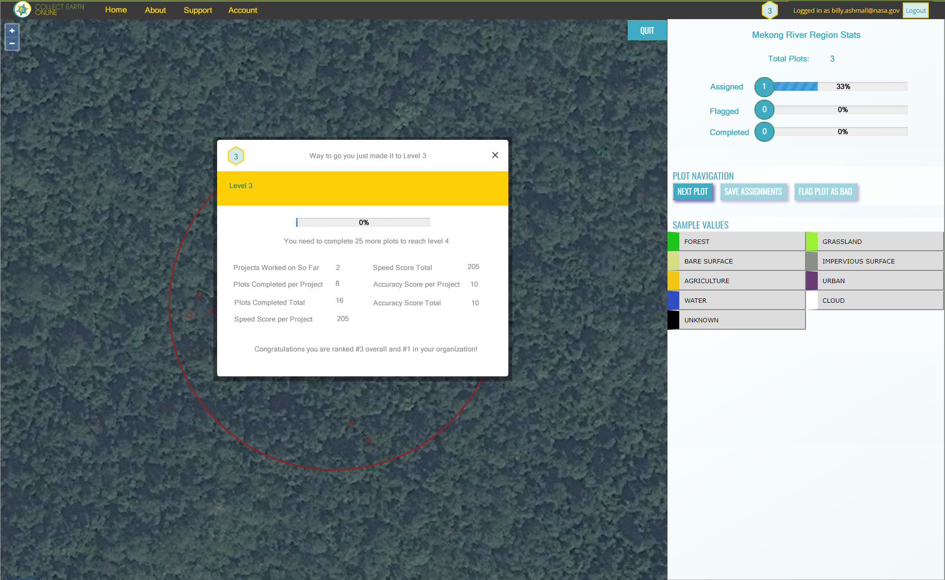
When a user levels up he will be shown the stats box with the new level and an encouraging message.
The badge in the menu bar must also be updated

Slide 8
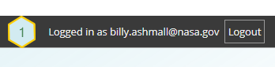
User engagement
When logged in the user is presented with a badge indicating their current level
User can click the badge to see their stats such as:
Projects Worked on So Far
Plots Completed per Project
Plots Completed Total
Speed Score per Project
Speed Score Total
Accuracy Score per Project
Accuracy Score Total
After each plot is complete show “X more plots to next level”
Consider showing his rank amongst other users (possibly organizational)
We will have to decide how to calculate levels but this doesn’t have to be a complex algorithm, it could be as simple as if numberOfPlotsCompleted >= (10 * level) then level = level + 1 Do something visual to let user know he leveled up and encourage him to keep going.

Slide 9
Discussion
This only addressed a small portion of the website and user experience. More discussion is needed on this topic to identify areas of opportunity to make CEO Great!

